Slide 1

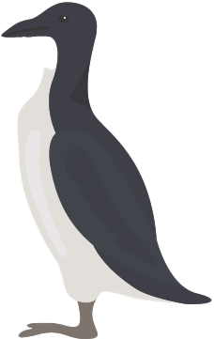
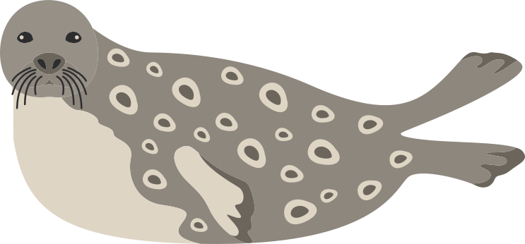
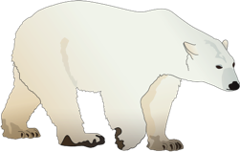
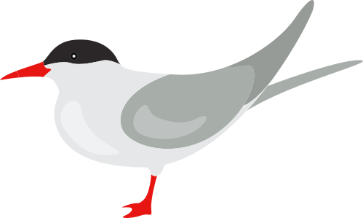
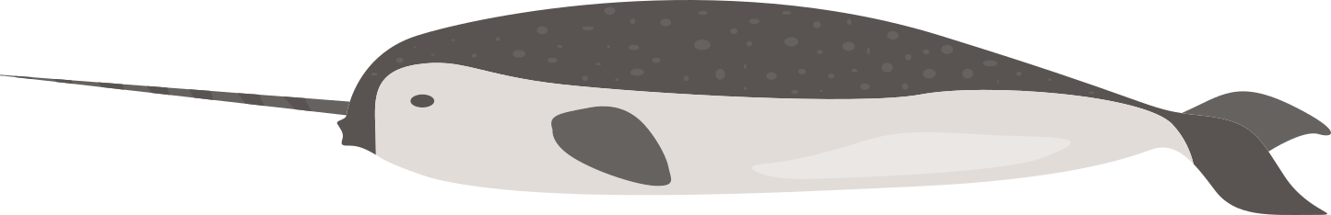
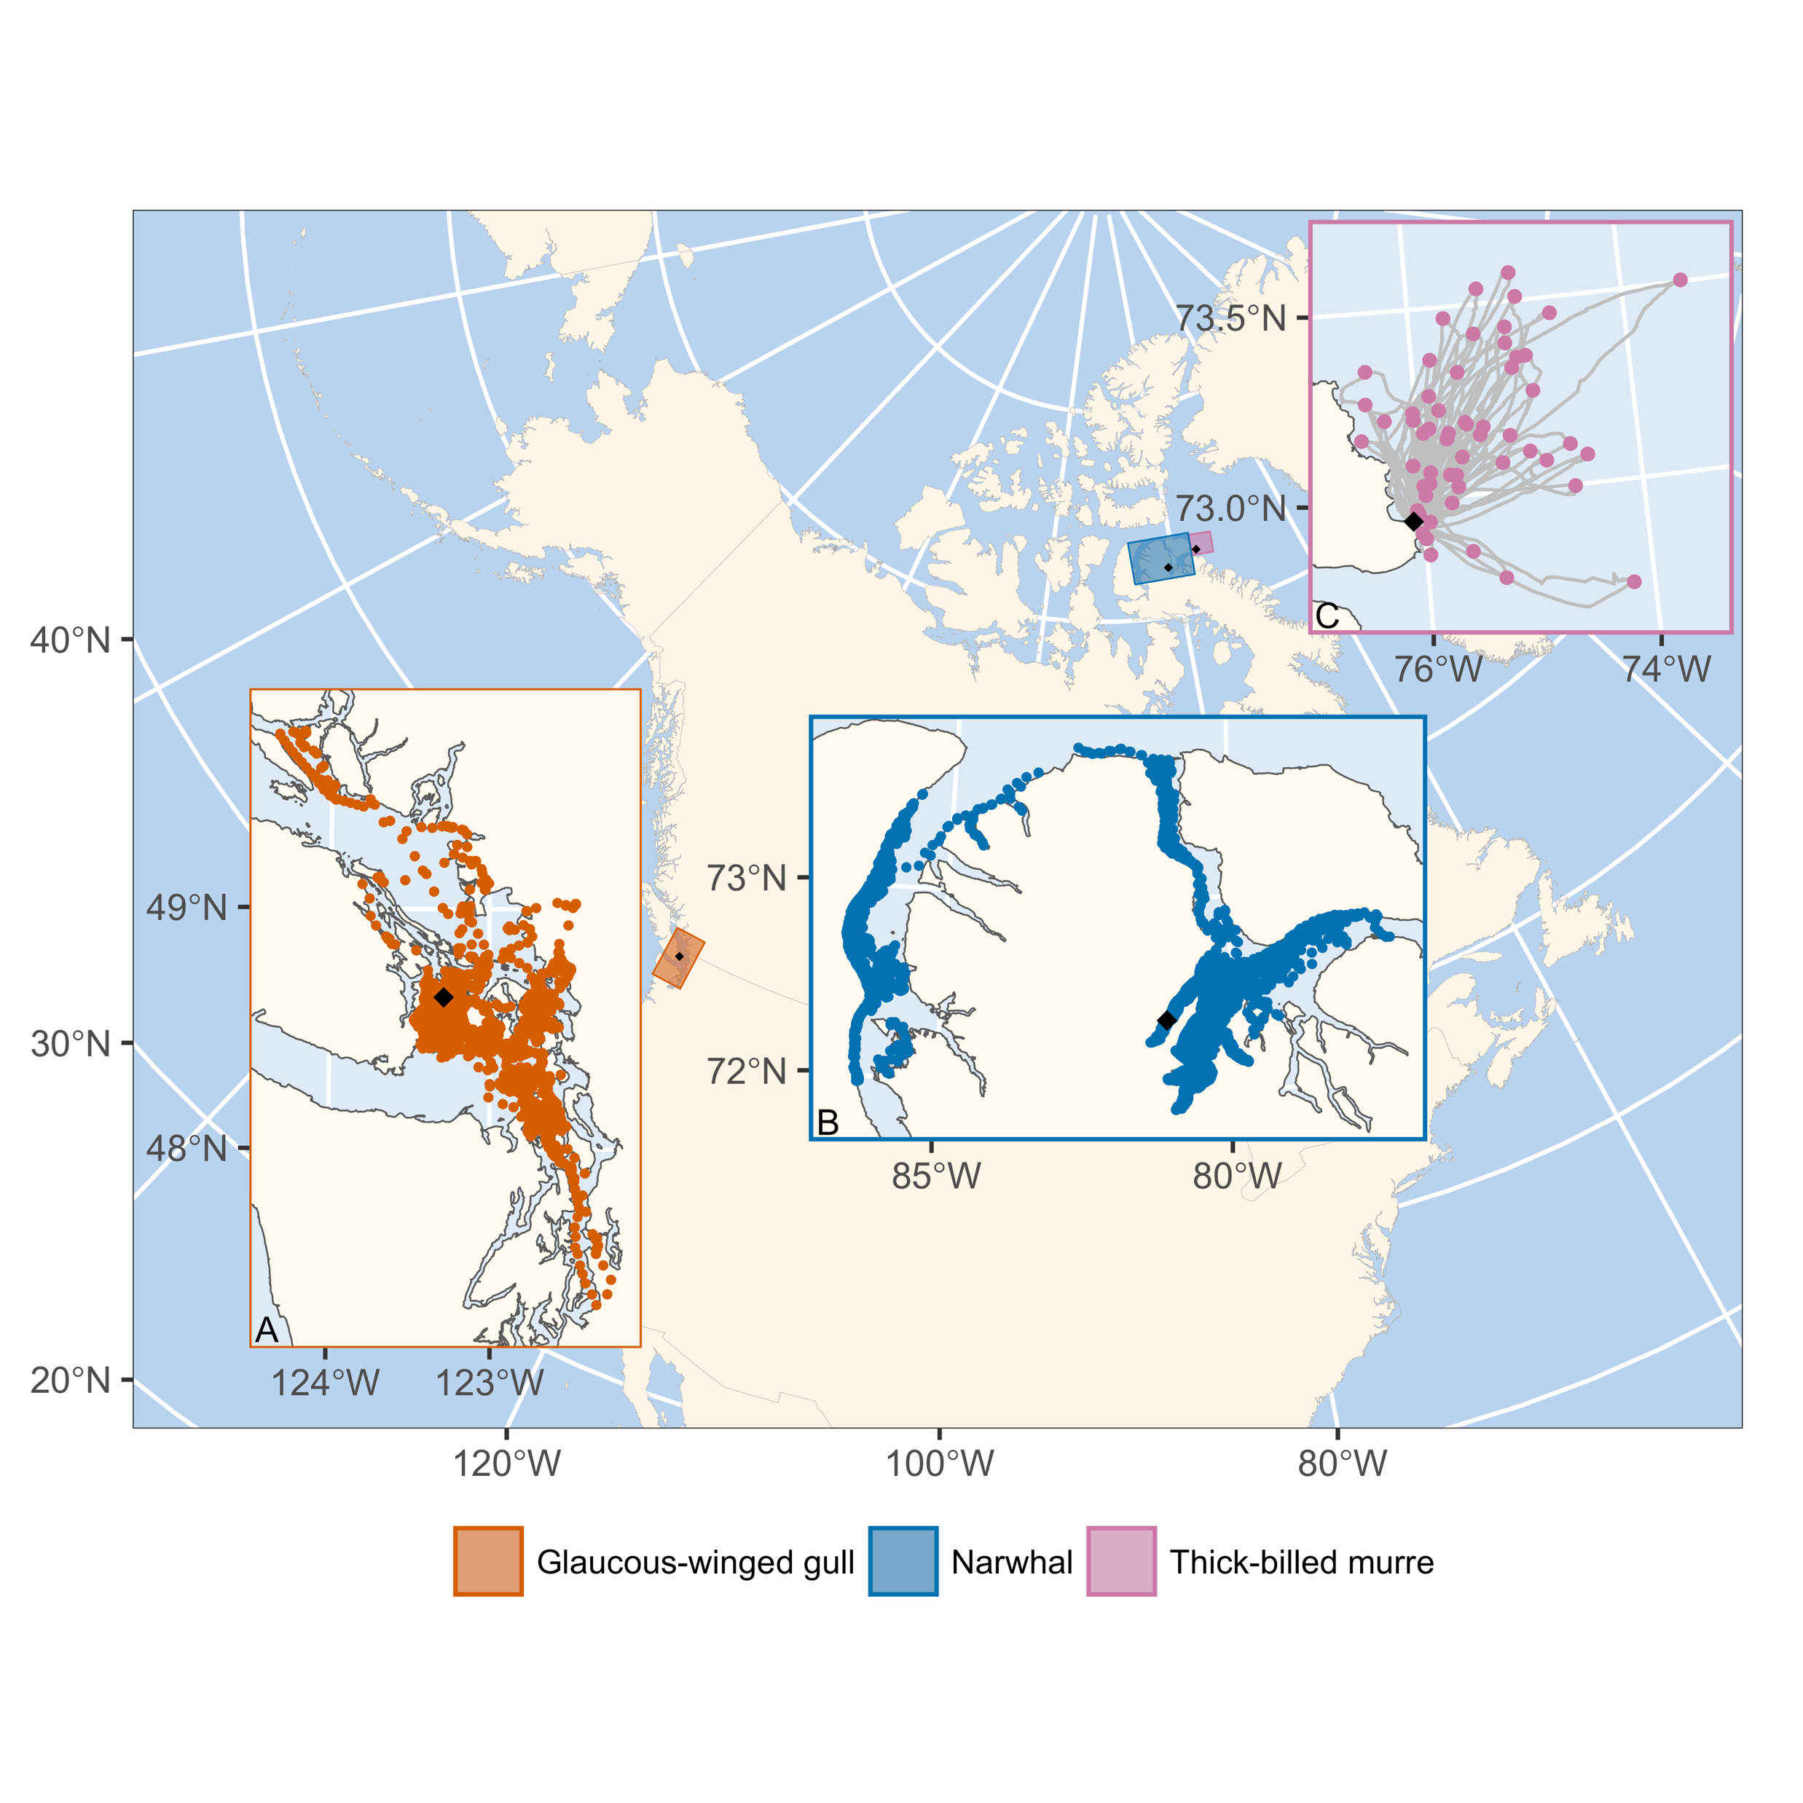
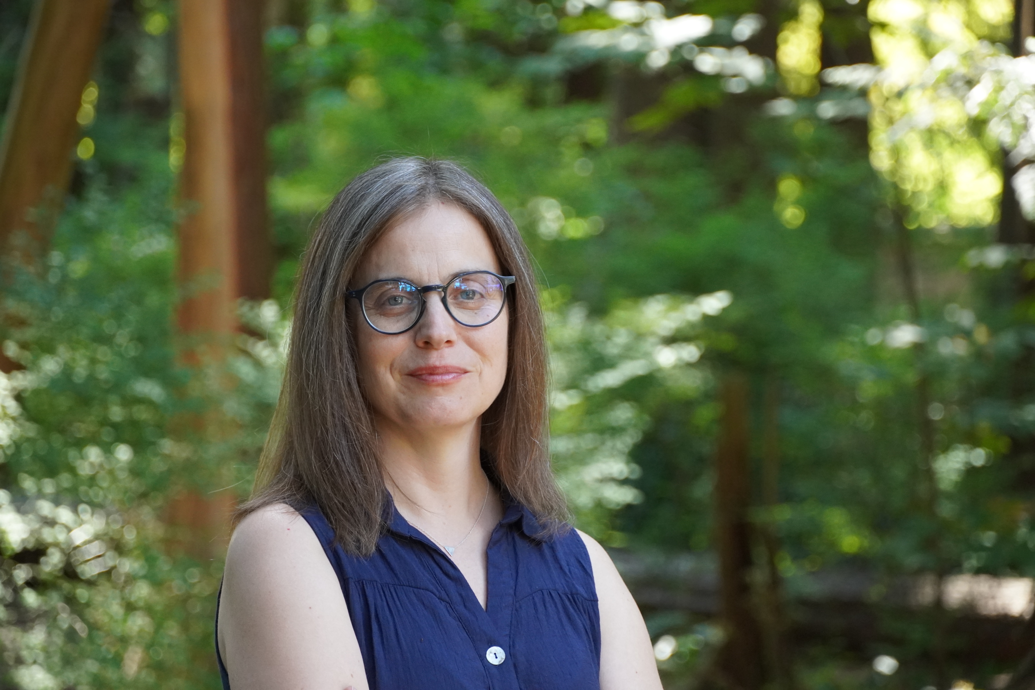
Study species:
Data: don’t own much data
Recently analysed datasets below: Thick-billed murres Narwhals Glaucous-winged gulls
Questions I am interested in:
Methods developments
The cause and consequence of movement variation
Developing better tools to conserve species
Challenges I lose sleep over:
1. Propagating uncertainty in complex analysis (e.g., when looking at habitat selection of species tagged with Argos data)
Live & work here
Trained as an ecologist, but now partly a statistician. Work mostly on animal movement data. I have a soft spot for the Arctic and the marine mammals that live there.
Marie Auger-Méthé @ University of British Columbia (m.auger-methe@oceans.ubc.ca
Personal webpage: https://statisticalecology.weebly.com ORCID: https://orcid.org/0000-0003-3550-4930

